Slide 1
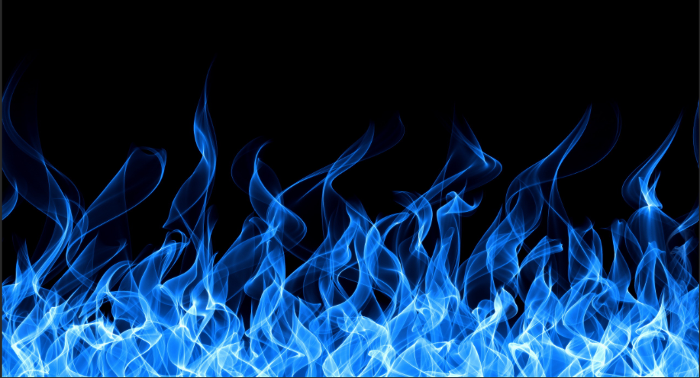
Fire Safety

Slide 2
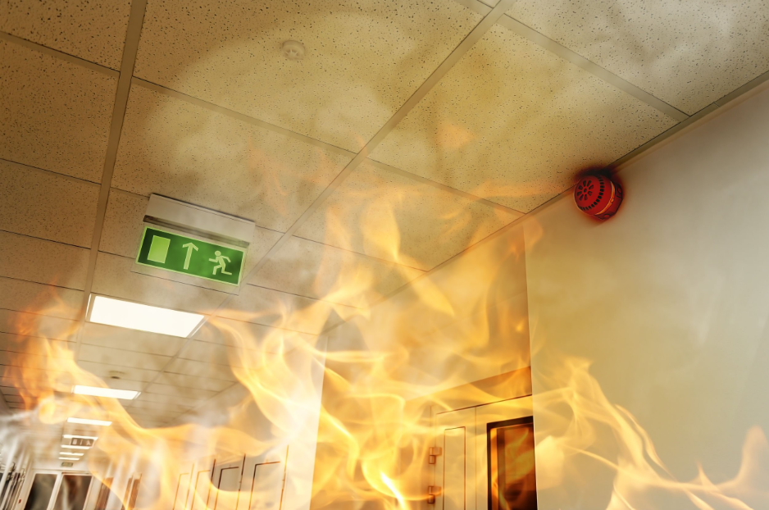
Fire safety Introduction
A fire department responds to a fire every 23 seconds. One home structure fire was reported every 93 seconds. And a home fire related injury occurs every 47 minutes. We will discuss fire safety and ways to avoid and be prepared today.

Slide 3
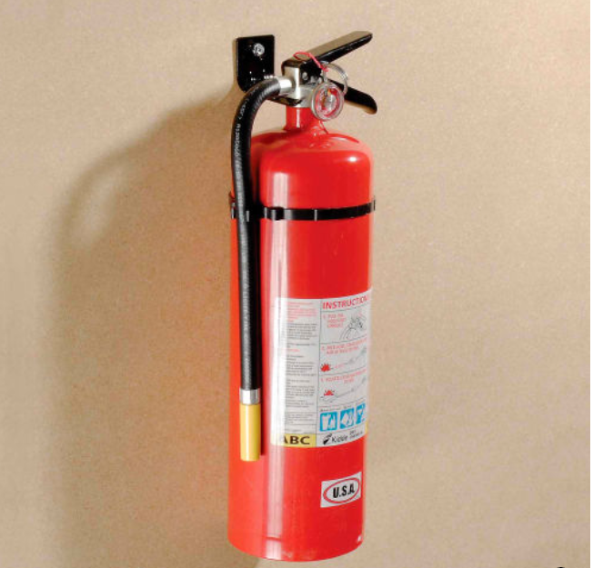
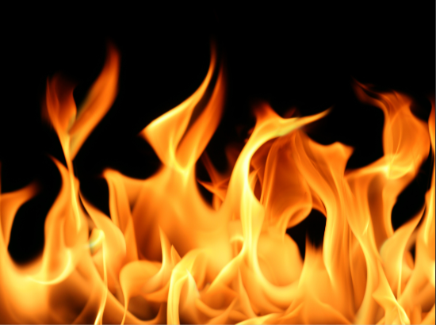
Training objectives for fire safety
How can a fire start?
Proper vehicle maintenance.
Fire Extinguishers and how to use them.
Being prepared.
When to evacuate.
Reporting a fire.
How to prevent a fier.

Slide 4
How do we cause a fire?
Lightning
Electrical caused by drilling
Smoking in or around home
Parking in tall grass

Slide 5
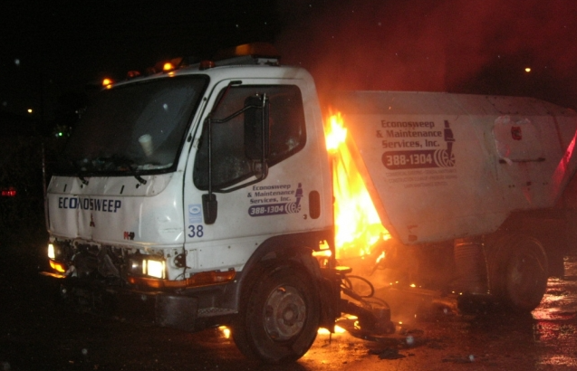
Vehicle Maintenance
Ensure that all our trucks follow corporate maintenance procedures.
Prevent exhaust leaks.
Coolant levels are checked to prevent over heating.

Slide 6
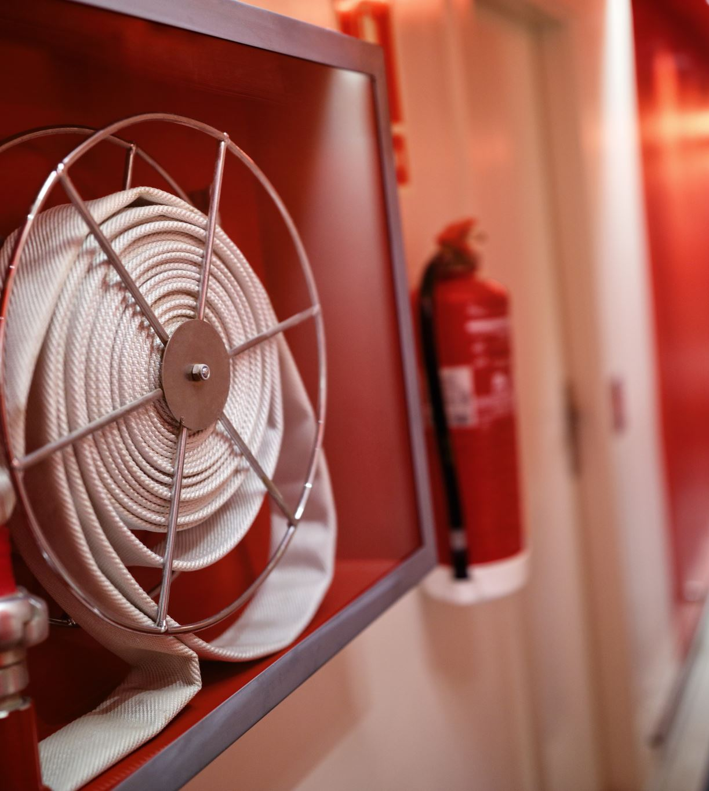
Fire extinguisher’s
Do not attempt to put out an overhead fire.
Extinguishers should be located every 75 feet in any direction.
Access to fire extinguishers should remain unobstructed
Do not rehang partially discharged extinguishers
All extinguishers should be checked and maintained properly and on a regular basis

Slide 7
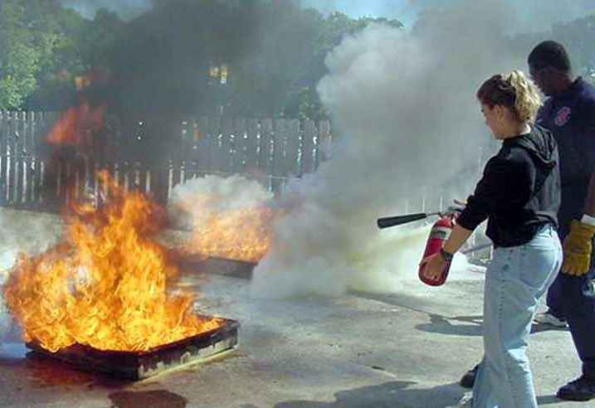
How to use a fire extinguisher.
Follow the acronym PASS to use a fire extinguisher SAFELY.
Pull the pin
Aim low, at the base of the fire
Squeeze the handle. Stand ten feet from fire
Sweep the hose from side to side.

Slide 8
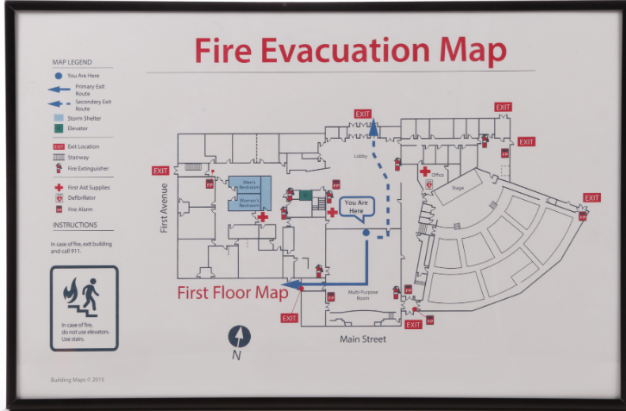
Be prepared.
Know where extinguishers are located
Know your evacuation route for all fire scanarios
Do not hesitate to call 911!!!!!!!!!
Clearly and calmly state your name, address, and location of fire.

Slide 9
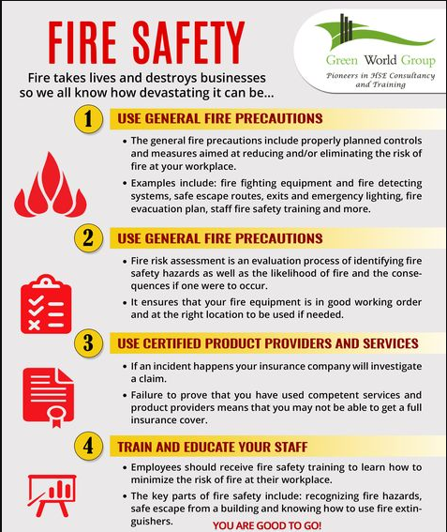
General fire Safety

