Slide 1
Welcome to the team!

Slide 2
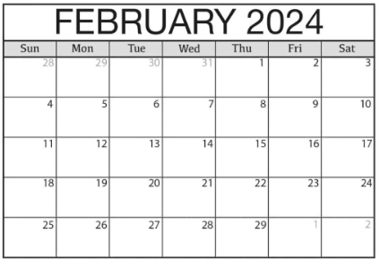
FIRST PAYCHECK
The Initial $500 Prepayment
You will receive a $500 prepayment, 11 days after the end of your first week of work with the Company.
For example, if you started working for the Company on February 5, 2024, you would receive a $500 prepayment on February 21, 2024.
START DATE
1ST PAY DAY $

Slide 3
SECOND PAYCHECK
Regular Weekly Payments
Thereafter, as long as you continue to work for the Company, you will receive regular weekly payments. Weekly payments are made 18 days after the end of the work week.
For example, if you started working for the Company on February 5, 2024, you would receive a regular weekly paycheck on February 28, 2024.
START DATE
1ST PAY DAY $
2nd PAY DAY $
WEEKLY PAY ON WEDNESDAY

Slide 4
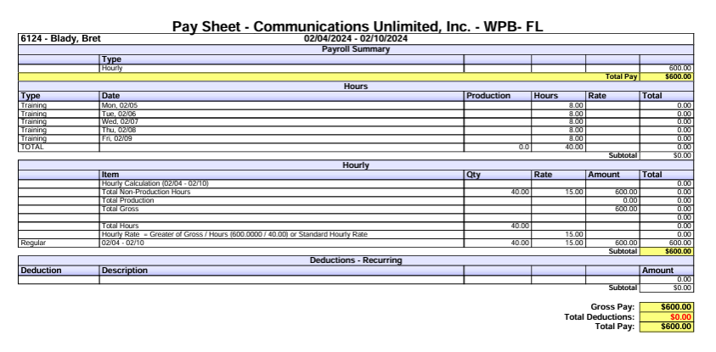
EXAMPLE OF TRAINING PAYCHECK – BEFORE TAXES
Training pay rate: $15.00 per hour

Slide 5
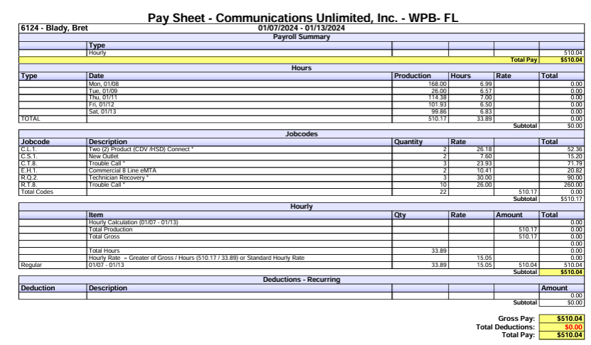
EXAMPLE #1 OF PRODUCTION PAYCHECK (REGULAR) – BEFORE TAXES
Hourly Rate = Greater of Gross / Hours or Standard Hourly Rate
BREAKDOWN
Hourly Rate = Greater of Gross / Hours (510.17 / 33.89) or Standard Hourly Rate
TOTAL PRODUCTION (JOBS COMPLETED): |  |  | $510.17
TOTAL HOURS: |  |  | 33.89
HOURLY RATE: |  |  | $15.05

Slide 6
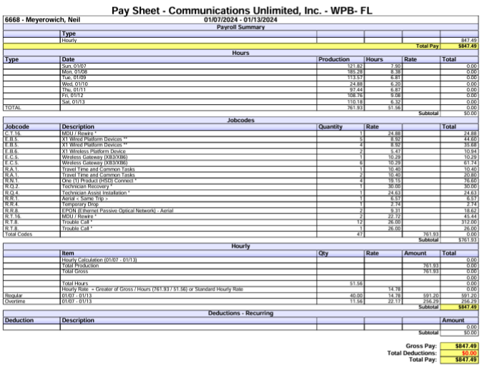
EXAMPLE # 2 OF PRODUCTION PAYCHECK (OVERTIME) - BEFORE TAXES
Hourly Rate = Greater of Gross / Hours or Standard Hourly Rate
BREAKDOWN
Hourly Rate = Greater of Gross / Hours (761.93 / 51.56) or Standard Hourly Rate
TOTAL PRODUCTION (JOBS COMPLETED): |  |  | $761.93
TOTAL HOURS: |  |  | 51.56
HOURLY RATE: 761.93 / 51.56 HOURS = $14.78
REGULAR HOURS: | 40 Hours x $14.78 = |  | $591.20
OVERTIME HOURS: | 11.56 Hours x $22.17 = |  | $256.29
 |  | TOTAL: | $847.49

Slide 7
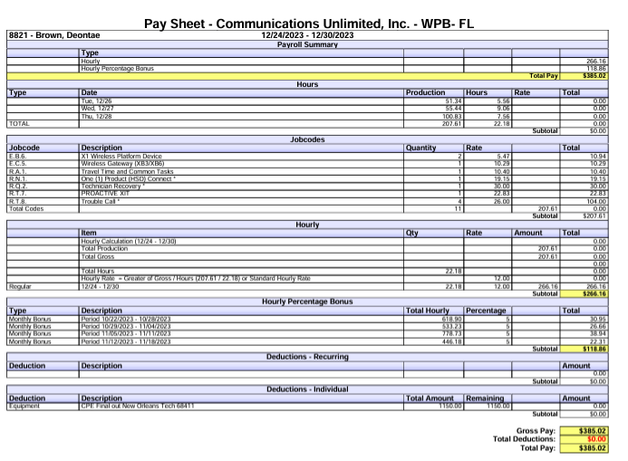
EXAMPLE # 3 OF PRODUCTION PAYCHECK (MIN WAGE) – BEFORE TAXES
Hourly Rate = Greater of Gross / Hours or Standard Hourly Rate
BREAKDOWN
Hourly Rate = Greater of Gross / Hours (207.61 / 22.18) or Standard Hourly Rate
TOTAL PRODUCTION (JOBS COMPLETED): | $207.61
TOTAL HOURS: | 22.18
HOURLY RATE: | $9.36
The payment is reverted to the regular hourly minimum wage rate because it is higher than the production earnings: 22.18 hours x $12.00 (FL Min wage)= $266.16

Slide 8
Please feel free to ask any questions you may have.
Thank you!

