Slide 1
Outlets: Home Wiring
1.1.2 All interior wiring after the service distribution enclosure or after the point of bonding at the bond block must use type indoor cable except where a higher-rated cable, riser or plenum, is required.
1.1.3 Messengered or PE jacketed underground flooded cable must never be used inside the customer premise.
1.1.4 Cables not approved or not certified by Cable Engineering for outdoor use must never be used for exterior wiring as they are not UV/ozone-stable and will deteriorate when installed outdoors

Slide 2
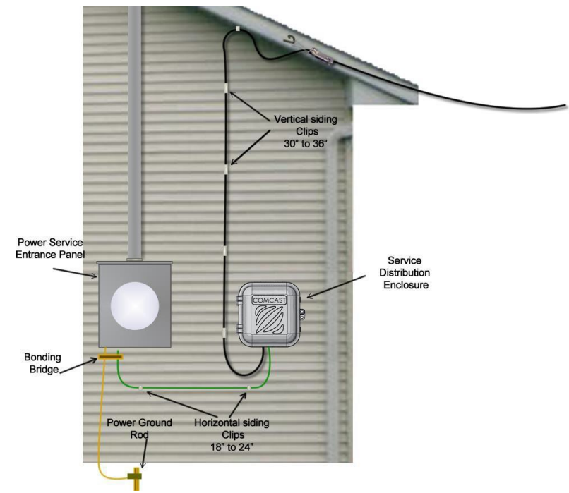
Outdoor Cable Routing and Attachment
1.2.1 Cable routing must follow the natural lines of the structure and must be done to minimize the visibility of the cable.
1.2.3 Cables, drop splitters, or other cable assets must NEVER be attached to rain gutters or downspouts.

Slide 3
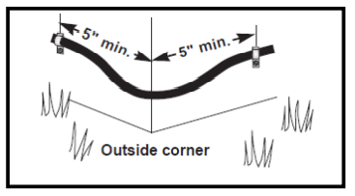
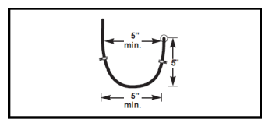
Outdoor Cable Routing and Attachment
1.2.1 Cable routing must follow the natural lines of the structure and must be done to minimize the visibility of the cable.
1.2.3 Cables, drop splitters, or other cable assets must NEVER be attached to rain gutters or downspouts.
1.2.4 Cable must be routed and fastened to maintain the minimum bend radius of the cable at all times.
1.2.7 NEVER make a 90-degree square corner with the cable to avoid damage to the cable.

Slide 4
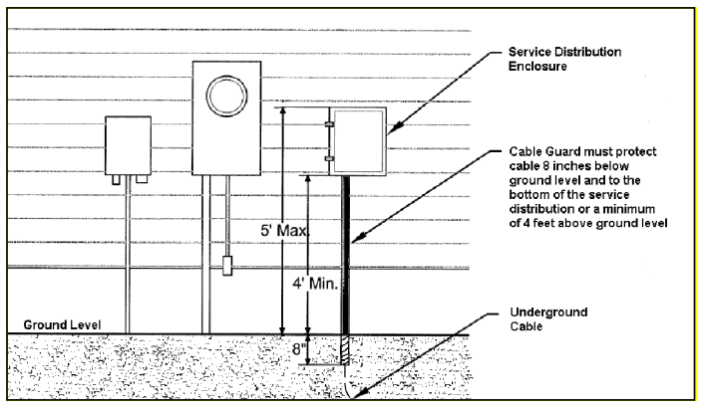
Outdoor Cable Routing and Attachment
1.2.5 Cable must be fastened or clipped every 18 to 24 inches if routed horizontally; and fastened or clipped every 30 to 36 inches if routed vertically.

Slide 5
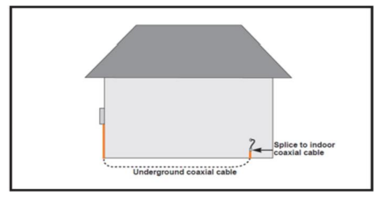
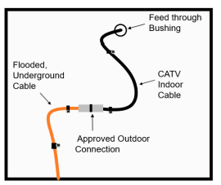
ROUTING AN OUTLET UNDERGROUND
1.3.1.1 All new Cable between the service distribution point and the entry to the home should be free of splices or splits.
1.3.1.2 The only exception is when routing Cable underground from the outside service distribution point or enclosure to the home entry point. Flooded, underground cable must be used and connected to inside CATV indoor cable using an approved outdoor connection. NEVER use underground cable into the house.

Slide 6
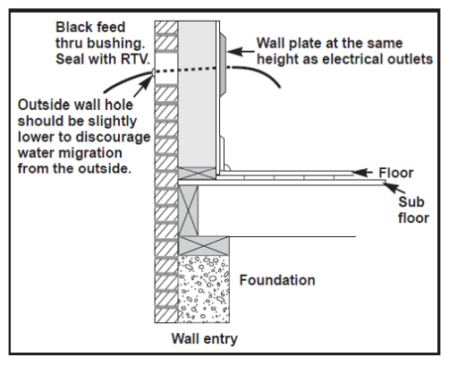
Home Entry
1.4.1 To prevent water damage, all exterior entry holes must be drilled so that the outside of the hole is slightly lower than the hole on the inside of the wall.

Slide 7
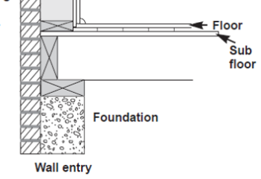
Home Entry
1.4.2 Outside entry hole drilling direction must consider the outside construction material of the home.
Drilling shall be from the inside out for wood or vinyl siding.
Drilling from the outside in for all other material including metal, slate, stucco, hard asphalt, or brick.
1.4.3 Always check the inside location for plumbing, electrical wires, gas lines, and any other hazards prior to drilling
1.4.4 Drilling of a foundation wall is prohibited unless all other means for cable entry into the home are exhausted.

Slide 8
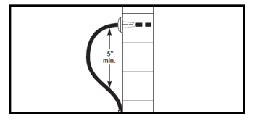
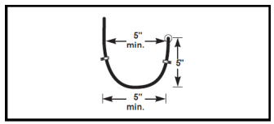
Home Entry – Cable Drip Loop
1.4.6 A minimum diameter drip loop, in accordance with the bending radius for the cable being used, must be formed below all outside entry holes anywhere cable enters the house. Before fastening the cable to the house wall, and BEFORE insertion through any outside entry hole.
1.4.7 Cable MUST ALWAYS enter the home from below the level of the outside entry hole, NEVER from above the entry hole, to prevent moisture from traveling down the cable and into the home.

Slide 9
Indoor Cable Routing and Attachment
1.5.1 All new outlets must be home run to the central primary service distribution point..
1.5.2 Never run cable under carpets, through door frames, through windows or window frames.
1.5.3 Cable routed through any floor/ceiling joists must NEVER be routed through holes occupied by any electrical wires.
1.5.4 Cable routes must maintain a minimum distance of 2 inches from any electrical wiring.
* Never drill through any floor or ceiling Joists!

Slide 10
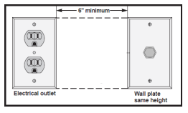
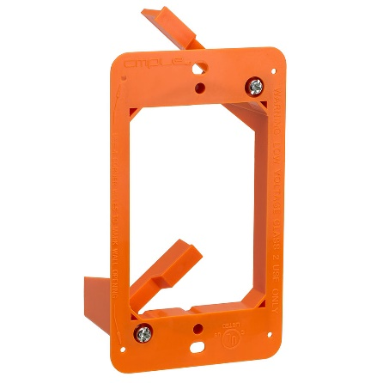
Indoor Cable Routing and Attachment
Wall Plate Installation
1.6.1 Distance between the wall plate and the CPE should not be more than 6 feet. If the equipment is located more than 6 feet away from the outlet, the jumper cable must be securely fastened in order to eliminate any safety hazard.
1.6.2 Wall plates must be level mounted at the same height as the electrical outlets in the room and no closer than 6 inches from any electrical outlet.

Slide 12
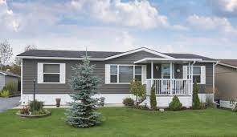
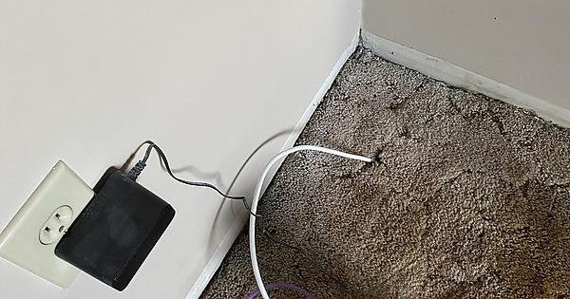
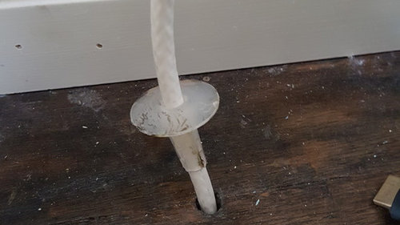
Home Entry – Mobile Home
1.4.8 Entry holes in mobile homes must be through the floor only. Never drill through the outside wall of a mobile home.
1.4.9 Always install a wall bushing in a floor entry hole for mobile homes before inserting the cable.

